Slide 1



X
Sales Performance Analytics Dahsboard
Kimia Farma - Big Data Analytics
Presented by
Muhammad Cikal Merdeka

Slide 2

Created by:
Muhammad Cikal Merdeka
Email : mcikalmerdeka@gmail.com
LinkedIn : linkedin.com/in/mcikalmerdeka
Github : github.com/mcikalmerdeka
Experience
Research Assistant
Institut Teknologi Bandung
January 2021 – April 2023
Laboratory Assistant
Institut Teknologi Bandung
August 2020 – May 2021
Dedicated entry-level data scientist with analytical and experimental background of Physics. My graduation 2023, a pivotal year marked by significant advancements in artificial intelligence with the introduction of GPT-4 and other generative AI models, has fueled my curiosity and excitement to delve into the field of data. I have comprehensive grasp of data science methodology from business understanding to modelling process with proficiency in Python, SQL, Tableau, Power BI, Looker Studio and other tools related to data analytics workflow from several coursework and bootcamps.
Education
Institut Teknologi Bandung
Bachelor of Physics
August 2018 – January 2023
Rakamin Academy
Data Science ML Specialization Bootcamp
October 2023 – March 2024

Slide 3


Portfolio Case Study
Kimia Farma is a state-owned enterprise Indonesian pharmaceutical company established in 1817, plays a vital role in Indonesia's healthcare sector, contributing to public health and wellness. It operates in the production, distribution, and retail of pharmaceutical products, including medicines, healthcare supplies, and medical devices. In this task we want to analyze the sales performance of its products over period of January 2020 - December 2023. Based on the data tables provided by the company, including Total Transactions, Inventory, Products, and Office Branch, we will perform visualizations aimed at determining :
Year-on-year Revenue Comparison of Kimia Farma
Top 10 Branches by Total Transactions in Each Province
Top 10 Branches by Net Sales in Each Province
Top 5 Branches with the Highest Ratings but Lowest Transaction Ratings
Geo Map of Indonesia Showing Total Profit by Each Province
(and other kinds of visualizations, depends on us)
Then, these visualizations we will gather business insights. The tech stack that we will be using are Google BigQuery (SQL) and Looker Studio.

Slide 4
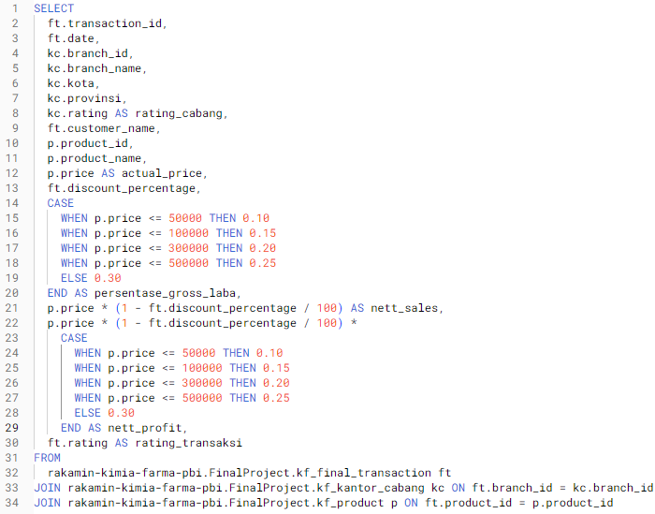
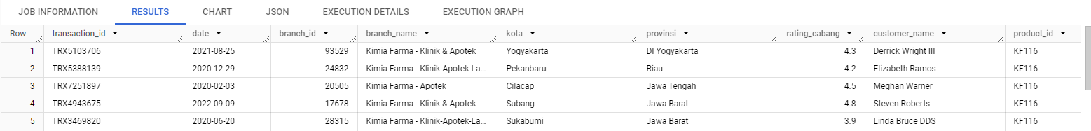
Stage 1 : Master Table Formulation
Before conducting the analysis in the form of a dashboard in Looker Studio, we need to merge the four tables by selecting columns that contain relevant information about what we will analyze, as explained in the query earlier. Here is the result of the master table.
The master table is directly loaded/connected to Looker Studio for analysis and not exported as csv in local because the size is too large (135 MB) for importing in Looker Studio through local (max 100 MB).

Slide 5
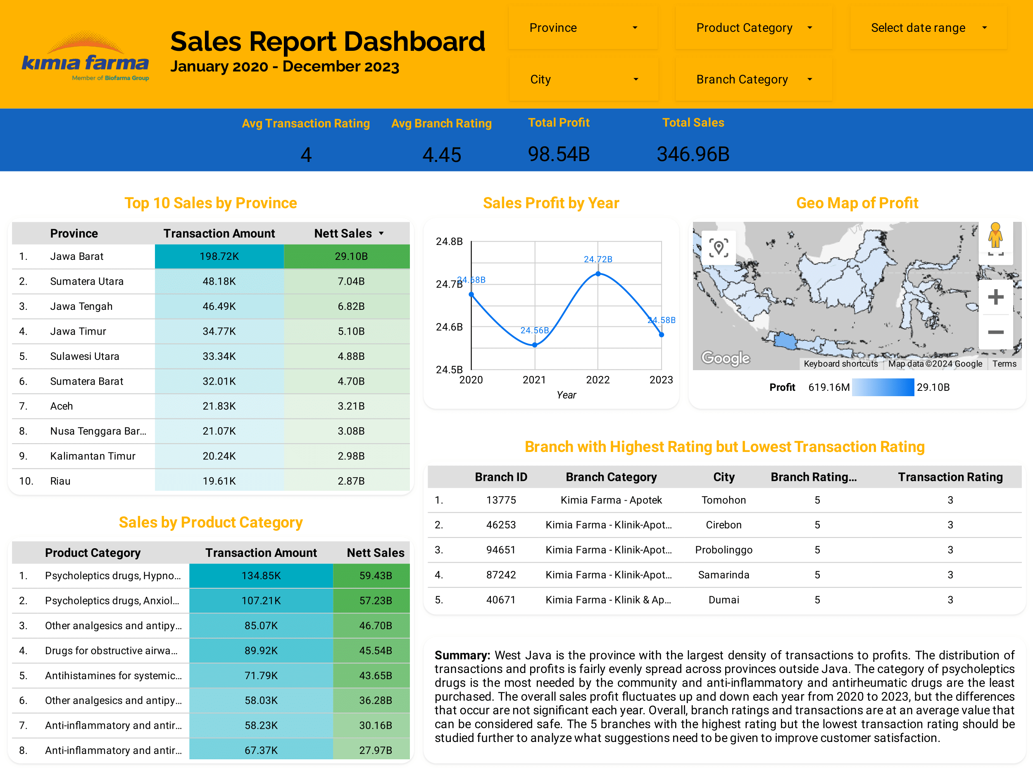
Stage 2 : Dashboard Creation
*explanation about the dashboard is included in the Summary part.

Slide 6
Thank You
X

